Slide 1
Does Currency drive society?
Candidate Number: 3192

Slide 2
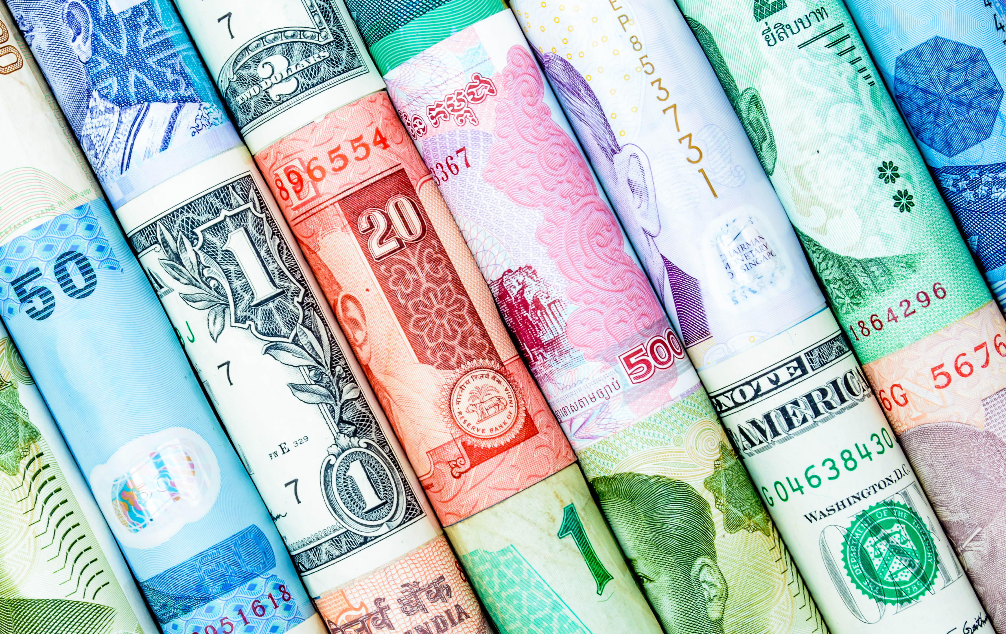
Individual Question
Does Currency Control Open Societies?
(Currency, 2017)

Slide 3
Key Terms
Open Society
(Oxford English Dictionary, 2017)
“A society characterized by a flexible structure, freedom of belief, and wide dissemination of information.”
Currency
(Merriam-Webster Dictionary, 2017)
“Something (as coins, treasury notes, and banknotes) that is in circulation as a medium of exchange”

Slide 4
Thesis
The wealth of individuals in open societies determines many aspects of their lives
Currency controls open societies because of the influence that it has in politics

Slide 5


Currency Influences Political Systems
Local
Global
One corporation, FPL, donated over $1.5 million to political campaigns in 2016, much of which was not able to be tracked to specific politicians. (Klas, 2017)
Many countries do not have substantial regulations on cash campaign donations. (Global Integrity, 2014)

Slide 6


Wealth Determines the Lives of Individuals
Local Example
Global
In Jacksonville, Florida, a model that represented the lower class was determined to have poorer health and educational attainment than a model that represented the upper class. (FDHDC, 2013)
A study conducted in England found that socioeconomic class has a very large influence on the success of children in school. (Shepherd, 2010)

Slide 7
Global Solution: Nordic Model
Examples of Success
Governmental Transparency in Sweden (The Economist, 2013)
Low Poverty Rates (Miller, 2014)

Slide 8
Local Solution: Limits on Campaign Spending
Canada
Belgium
Canada limits campaign donations to candidates and political parties to $1,550. (Elections Canada, No Date)
Canada is the 9th least corrupted country in the world. (Transparency International, 2016)
Belgium limits campaign donations to €2,000 per donor, per year. (IDEA, 2012)
Belgium is the 15th least corrupted country in the world. (Transparency International, 2016)

Slide 9
Local Solution: Limits on Campaign Spending
Canada: 9th most transparent
Belgium: 15th most transparent
(Transparency International, 2016)
$1,550 limit in Canada
(Elections Canada, No Date)
€2,000 limit in Belgium
(IDEA, 2012)

Slide 10
Conclusion
Does Currency Drive Society?
Does Currency Control Open Societies?
Reasons
Solutions and analysis
Outro

